Slide 1
Airline Fare Prediction Using ML
Guide Name-:Mr.Sumit Kumar Submitted By-:
Mishra Deepti Bansal
(Assistant Professor 1750810023
CSE Department) CS 41

Slide 2
TABLE OF CONTENTS
INTRODUCTION
PROBLEM STATEMENT
OBJECTIVE
LITERATURE REVIEW
IMPLEMENTATION/FINDINGS/EXPERIMENT
HARDWARE/SOFTWARE REQUIREMENTS
DATA FLOW DIAGRAM
RESULT
CONCLUSION
FUTURE SCOPE
REFERENCES

Slide 3
INTRODUCTION
In the Present time Airline Industry plays a very important role in Day-to-Day life. Customers can book their seat according to their choice from any place in the world, as long as they are connected to internet. This Innovation in technology has made traveling in the air easier and faster for the customers with airline reservation system by just a click away.
Nowadays, prices for the nearby seats within the same cabin in a flight can vary dynamically and significantly. Customers seek for the lowest price while airlines are busy in making profit .They are trying to keep their overall revenue as high as possible to maximize their profit. Airlines use various kinds of computational techniques to increase their revenue such as demand forecasting and price discrimination.

Slide 4
Flight ticket prices can be something hard to guess, today we might see a price, check out the price of the same flight tomorrow, it will be a different story. We might have often heard travelers saying that flight ticket prices are so unpredictable. As a CSE student, I’m going to prove that, if given the right data anything can be predicted.

Slide 5
PROBLEM STATEMENT
These days, airline ticket prices can vary considerably and significantly on the same plane, even in nearby seats within the same cabin. Customers want to get the lowest price while the airlines try to keep their total cost as high as possible and make their profits more. Airlines use a variety of computer techniques to increase revenue such as demand estimates and price discrimination.
On the customer side, two types of models are proposed by various investigators to save money for customers: models predicting the right time to buy a ticket and models predicting the low number of tickets. We might have often heard travelers saying that flight ticket prices are so unpredictable.

Slide 6
OBJECTIVE
The main Objective of the project is to predict the fare of the flight by using Different Machine Learning Algorithms.
Anyone who purchase flight tickets frequently ,would be able to predict the right price to procure a ticket
To optimize time /money savings .

Slide 7
Literature Review
Reference | Addressed Problem | Dataset | Features | Computational Techniques Used | Performance Result | Remark
Y. Chen et al., (2015) | Minimum Ticket Price Prediction | More than 3 months (110 days) data for 5 international routes. | Prices of the same itinerary, prices of recent itineraries before the target day, prices of itineraries with the same day of week, price of itineraries with the same day of month | An ensemble-based learning algorithm Learn++.NSE is modified and used | Mean absolute percentage error (MAPE) of 10.7% as compared to KNN (12.58) and PA (15.41%). | Not possible to predict price for a flight Does not consider multi-stop flights
Anastasia Lantseva et al., (2015) | Ticket Price per kilometer Prediction | Ticket price data collected for 75 days and 90 days for local and international flights. | City of departure, destination, ticket purchase date, departure date, ticket options with the price | Regression Model | Not given | No performance evaluation presented. The dataset set is limited

Slide 8
(K. Lazaridis et al., (2017) | Comparing regression machine learning models for predicting airline ticket prices. | A dataset consisting of 1814 flights for a single international route | Departure time, arrival time, number of free luggage, days before departure, number of intermediate stops, holiday, time of day and day of week | Eight regression machine learning models used | Bagging Regression: 87.42%, accuracy and Random Forest Regression Tree: 85.91%. accuracy | NA
T. Liu et al., (2017) | Predicting the lowest price available before departure date | Data consisting of 19 different routes and spans three months period (92 days). | Historical ticket prices, a signal indicating whether the departure date is holiday or not and number of days before departure | Ensemble model that uses techniques such as K-Nearest Neighbors, Random Forest and Bayesian | Improved the MAPE from (7% −12%) to (3.7% − 6%).as compared to the single model | NA

Slide 9
TECHNOLOGIES USED
Technologies required for the completion of the project-:
PYTHON-: Python is an interpreted, high-level and general-purpose programming language. Python's design philosophy emphasizes code readability with its notable use of significant whitespace. Its language constructs and object-oriented approach aim to help programmers write clear, logical code for small and large-scale projects.Python is dynamically typed and garbage-collected. It supports multiple programming paradigms, including structured (particularly, procedural), object-oriented and functional programming.
MACHINE LEARNING-: Machine learning (ML) is the study of computer algorithms that improve automatically through experience. It is seen as a subset of artificial intelligence. Machine learning algorithms build a model based on sample data, known as "training data", in order to make predictions or decisions without being explicitly programmed to do so. Machine learning algorithms are used in a wide variety of applications, such as email filtering and computer vision, where it is difficult or unfeasible to develop conventional algorithms to perform the needed tasks.

Slide 10
IMPLEMENTATION/FINDINGS/EXPERIMENTS
DATA CLEANING: Data cleaning is the process of preparing data for analysis by removing or modifying data that is incorrect, incomplete, irrelevant, duplicated, or improperly formatted. This data is usually not necessary or helpful when it comes to analyzing data because it may hinder the process or provide inaccurate results.
DATA PROCESSING:-Data Preprocessing is that step in which the data gets transformed, or Encoded, to bring it to such a state that now the machine can easily parse it. In other words, the features of the data can now be easily interpreted by the algorithm.
MACHINE LEARNING MODELS:- We have used different machine learning models for prediction to get the accurate results.

Slide 11
MODELS USED
Linear Regression
Ridge Regression
Lasso Regression:
Random Forest Regressor
Gradient Boosting Regressor

Slide 12
Hardware Requirement
Processor - 2.4 GHz ,should be multi-processor
RAM - Minimum 4GB(Recommended 8GB)
Monitor - Any
Keyboard - 104 keys
Mouse - Logitech serial Mouse
Memory - 1TB Hard Disk Drive / 256GB Secondary Storage Device
Graphics Card - Any

Slide 13
Software/Tools Used
Python Programming Language(Version 3.7)
Python IDE
Jupyter Notebook IDE
Machine Learning Algorithms
Scikit-Learn
Numpy
Pandas
Matplotlib
Seaborn

Slide 14
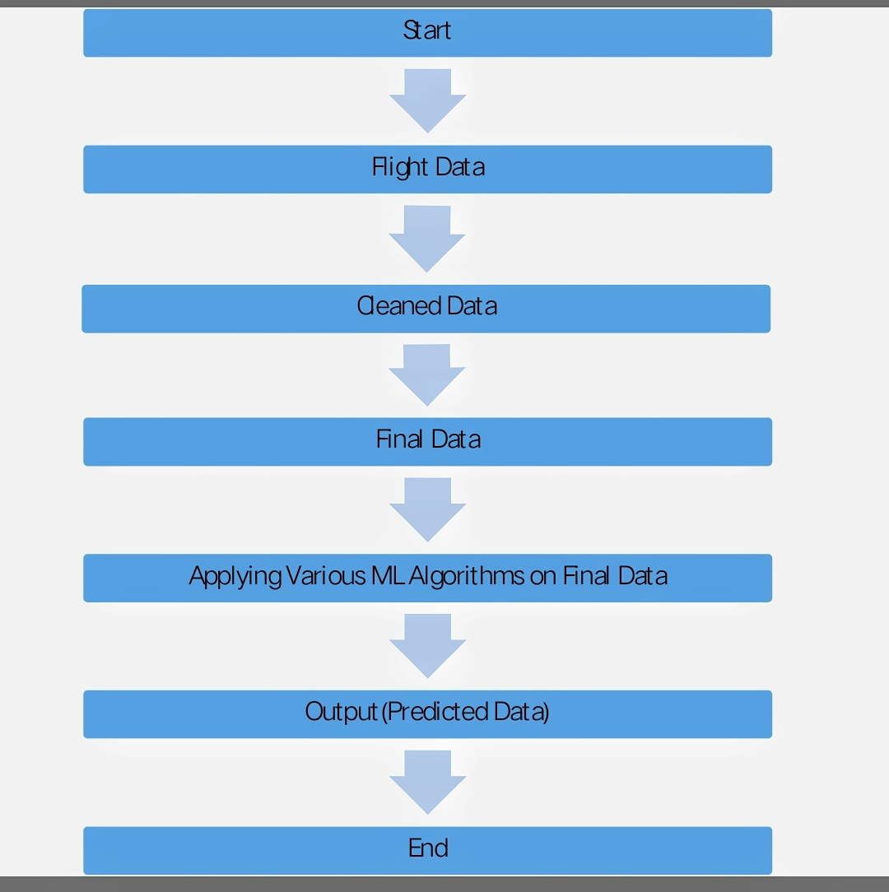
DATA FLOW DIAGRAM

Slide 15
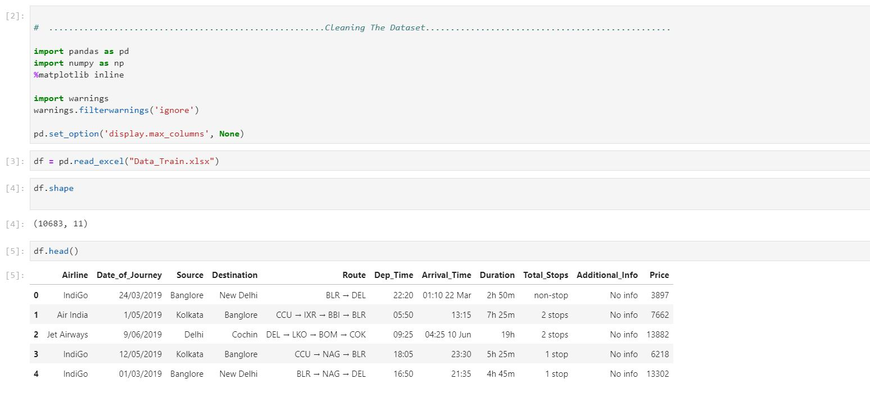
RESULTS

Slide 16
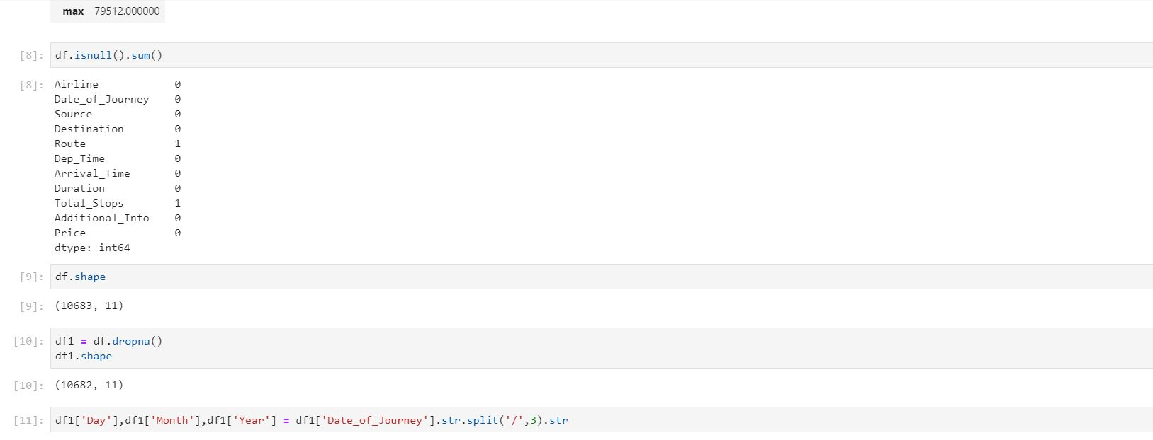

Slide 17
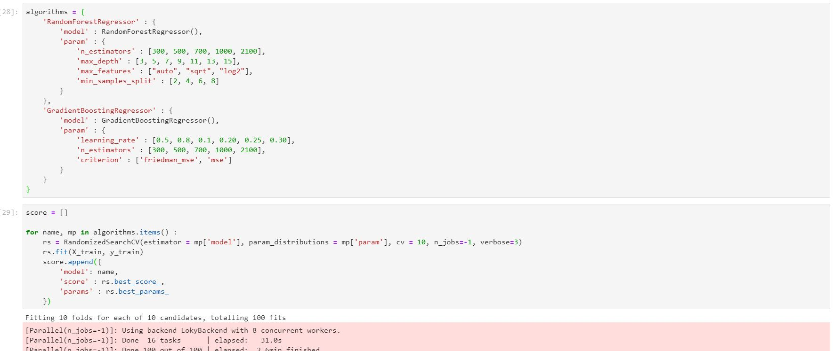

Slide 18
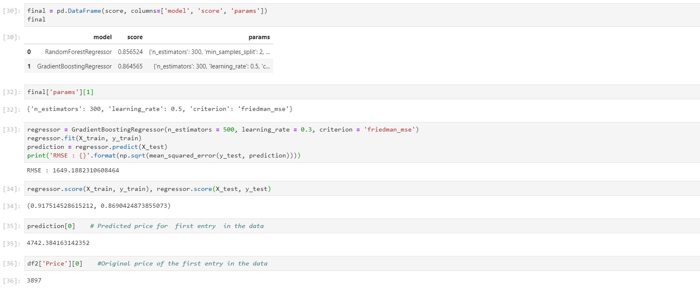

Slide 19
CONCLUSION
Choosing the right system gaining knowledge of technique depends on the hassle type, size of a dataset, assets, and many others. A great practice is to use several fashions to both streamline assessment and reap higher accuracy. With this project, we are developing a machine learning model that can predict flight prices. The Gradient Boosting Regression model and the Random Tree Regressor are giving the best accuracy. Most accurate results are given by Gradient boost Regressor. Also, it was observed that from the data collected and through exploratory data analysis, we can determine the following:
The trend of flight prices varies over various months and across the holiday There are two groups of airlines: the economical group and the luxurious group. SpiceJet, AirAsia, IndiGo, Go Air are in the economical class, whereas Jet Airways and Air India in the other. Vistara has a more spread-out trend. The airfare varies depending on the time of departure, making timeslot used in analysis an important parameter.

Slide 20
FUTURE SCOPE
● More routes can be added and similar analysis can be extended to major airports and routes in India.
● Analysis can be done by increasing the data points and increasing the historical data used. That will train the model by better providing relevant details and more savings.
● Many routes can be added to Route-based education based on our understanding of the industry, including the delivery times provided by airlines.
● Creating an easy-to-use interface for various routes that provides additional flexibility for users

Slide 21
REFERENCES
B. Smith, J. Leimkuhler, R. Darrow, and Samuels,―Yield management at american airlines,‖Interfaces, vol.22, pp. 8–31, 1992.
W. Groves and M. Gini, ―An agent for optimizing airline ticket purchasing,‖ 12th International Conference on Autonomous Agents and Multiagent Systems (AAMAS 2013), St. Paul, MN, May 06 - 10, 2013 , pp. 1341-1342.
T. Janssen, ―A linear quantile mixed regression model for prediction of airline ticket prices,‖ Bachelor Thesis, Radboud University, 2014.
Viet Hoang Vu, Quang Tran Minh and Phu H. Phung,‖An Airfare Prediction Model for Developing Markets‖, IEEE paper 2018.

Slide 22
S.B. Kotsiantis, ―Decision trees: a recent overview,‖ Artificial Intelligence Review, vol. 39, no. 4, pp. 261-283, 2013.
L. Breiman, ―Random forests,‖ Machine Learning, vol. 45, pp. 5- 32 , 2001.
S. Haykin, Neural Networks – A Comprehensive Foundation. Prentice Hall, 2nd Edition, 1999.
H. Drucker, C.J.C. Burges, L. Kaufman, A. Smola and V. Vapnik, ‖Support vector regression machines,‖ Advances in neural information processing systems, vol. 9, pp. 155-161,
Wohlfarth, T. Clemencon, S.Roueff, ―A Data mining approach to travel price forecasting‖, 10th international conference on machine learning Honolulu 2011.
Dominguez-Menchero, J.Santo, Riviera, ‖optimal purchase timing in airline markets‖ ,2014

Slide 23


